Slide 1

IMDB Movie & Director Insights Dashboard
A Power BI Data Analytics Case Study
Leveraging data-driven insights to evaluate global box office revenue, profitability, and director performance metrics.

Slide 2

THE MISSION
Project Objectives
Identify Trends: Pinpoint top-tier revenue drivers and high-margin productions.
Director Analysis: Evaluate individual impact on commercial success.
Audience Sentiment: Correlate ratings with financial performance.
Interactive UI: Design a seamless stakeholder reporting experience.

Slide 3







THE STACK
Tools & Technologies
SQL
Power BI
Data extraction, cleaning, and complex querying of raw IMDB tables.
End-to-end data modeling and sophisticated visualization design.
DAX
Custom KPI measures for weighted ratings and profit margins.

Slide 4

Dataset Scope
A curated analysis focusing on high-impact global cinema releases.
47 Key Movies
Core Metrics
Demographics
High-budget international releases with complete financial data.
Revenue, Profit, Genre, Audience Ratings, and Popularity Scores.
Comprehensive director profiles including gender and career history.

Slide 5

EXECUTIVE SUMMARY
Key Performance Indicators
$38.5B
$28.3B
6.57
90.5
Total Revenue
Total Profit
Avg Rating
Popularity
Cumulative global box office
Net earnings after budget
IMDB user score average
Metadata interest index
Data indicates a strong positive correlation between high production budget and global profitability.

Slide 6

Industry Representation
Directors by Gender
The Diversity Gap
The analysis reveals a significant disparity in director representation within high-revenue film production.
93.6% Male dominance in major studio projects.
6.4% Female representation highlights a critical industry gap.
Male
Female

Slide 7





Top 10 Movies by Revenue
Commercial giants dominating the global box office.
Franchise Dominance
Market Patterns
Avatar and Titanic lead as standalone hits, while Avengers and Jurassic World showcase franchise power.
Action, Sci-Fi, and Adventure genres yield the highest ROI for major studios.

Slide 8
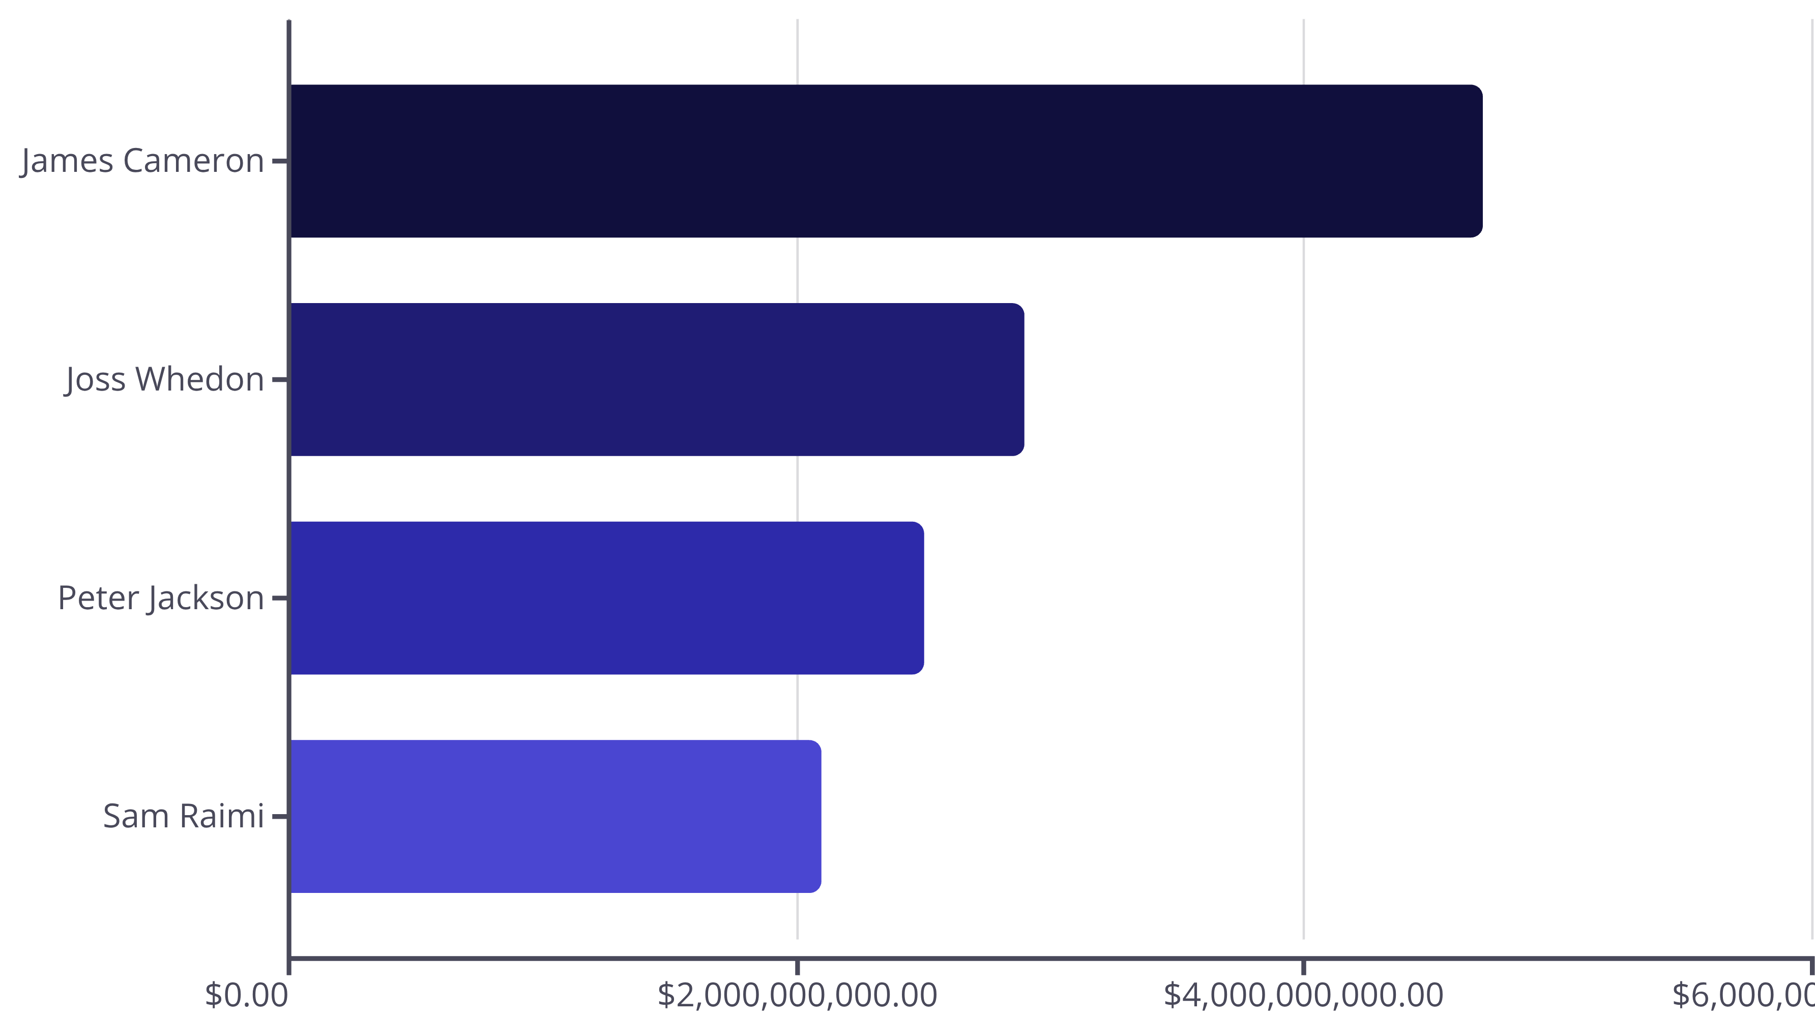
Elite Director Performance
The creative minds behind the billions.
James Cameron remains the primary contributor to record-breaking revenue in this dataset.

Slide 9




Dashboard Functionality
Dynamic Filtering
Integrated slicers allow users to drill down by director, year, or genre instantly.
Real-time Updates
All charts are cross-filtered, ensuring visual consistency across the entire report.
Deep Comparison
Easy side-by-side benchmarking of movie performance vs. director track records.

Slide 10



Conclusion & Key Learnings
Technical Proficiency
Mastered the SQL to Power BI workflow for clean data pipelines.
Strategic Insight
Identified clear revenue patterns and critical representation gaps.
Business Readiness
Demonstrated ability to translate raw data into actionable stakeholder stories.
Ready for BI Roles

